Slide 1
Welcome to Båring Børneunivers – our kindergarden
The whole univers has about 176 Children at the age 0-13 years old -
30 teachers and pedagogs, assistants, administration and technical staff .

Slide 2
Foundation for our work and activities in the kindergarden
The strengthened
pedagogical
curriculum - a new political act from 2018
Since 2004, all Danish kindergardens have had to work on
children's learning based on a pedagogical curriculum
Working basis for all kindergartens in Middelfart 2018-2021
Middelfart municipality vision :
“From Middelfart-child to Citizen of the world.”

Slide 3
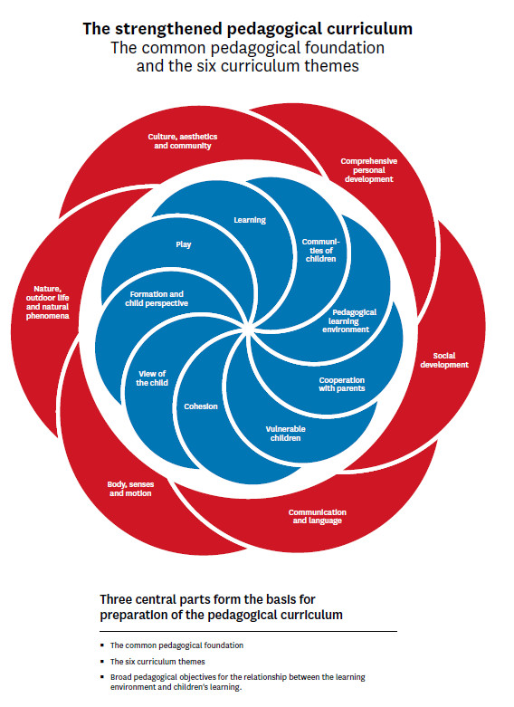

Slide 4
The new things in the padagogical curriculum
- A common pedagogical foundation with key elements
e.g. play, communities of children and a broad concept of
learning, constituting the understanding and approach to work
on children's wellbeing, learning, development and formation.
- Establishing a pedagogical learning environment
throughout the day, including in routine situations,
planned activities and child-initiated play.
- That the pedagogical curriculum should relate to
vulnerable children, cooperation with parents on
children's learning, continuity to preschool class as
well as cooperation with the surrounding community.
- Establishing an evaluation culture in kindergarden setting.

Slide 5
Working basis for all the kindergardens in Middelfart
View on the child and childhood:
To be a child, has value in itsself.
Meet the children where they are in their age development, and the children are ment to and inclined to be, - co-creators of their own learning and formation. The zone for next learning.
-Build Children’s communities in the kindergarten – Everybody has a right to a best friend or friends.
Kindergarden life must ensure every childs options and posibilities in participating in both learning and in playing activities in general.

Slide 6
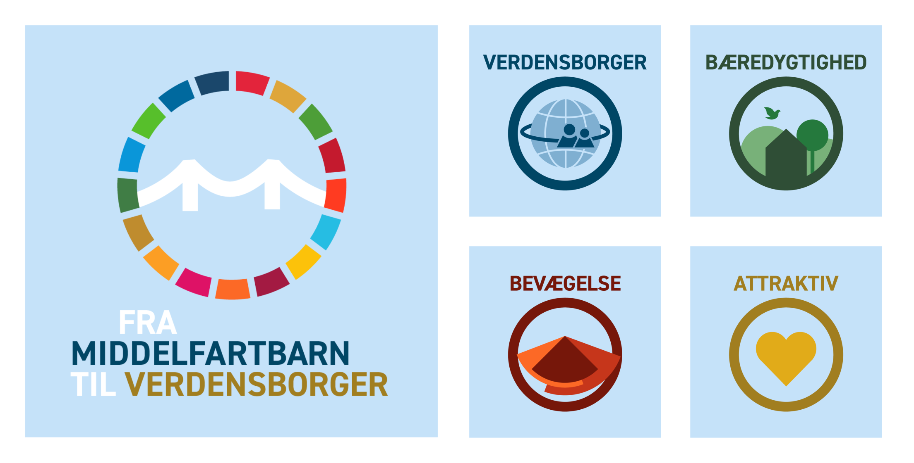

Slide 7
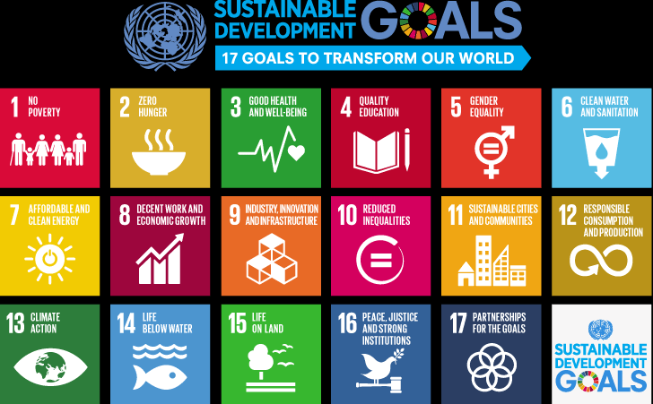

Slide 8
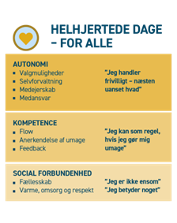
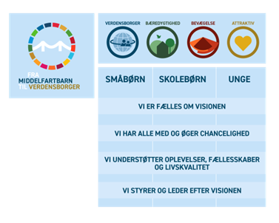
“ From Middelfart-child to Citizen of the world “
0-6 years old

Slide 9
The everyday structure
1. "learning space": Focus on targeted organized learning groups - where adults take responsibility for putting communities together (adults in front of the children)
2. "learning space": Focus on "space" for the freer play and learning processes - where children themselves choose communities - and with accessible adults. (adults behind the children)
3. “learning space”: Focus on targeted learning activities such as offers and “highlights - (often combined with learning space 2) ( adults and children develop together)
4. “learning space": Focus on all small and large everyday learning processes - e.g. adults make lunchtime, toilet- routines, clothes mastering , sleeping processes, into important learning skills and achivements.

Slide 10
Goals in the Middelfart strategy for understanding and using technology
• Children are not just consumers - they are co-creators in the use of digital media
• The pedagogical staff takes responsibility and uses digital tools in the pedagogical practice to develop and support the pedagogical core task
• The pedagogical staff is able to “transform” the learning process into new forms of learning, where apps, videos, e-books, photo reports, coding etc. is included

Slide 11
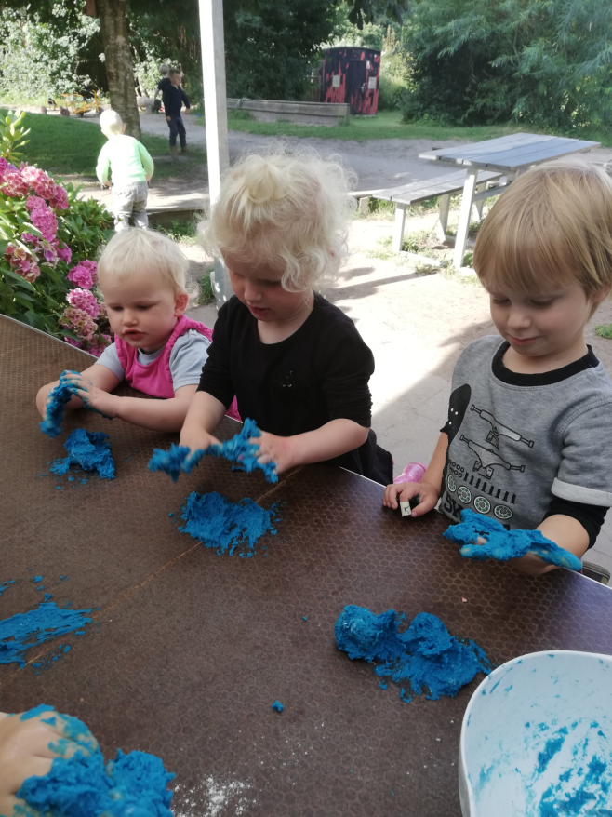
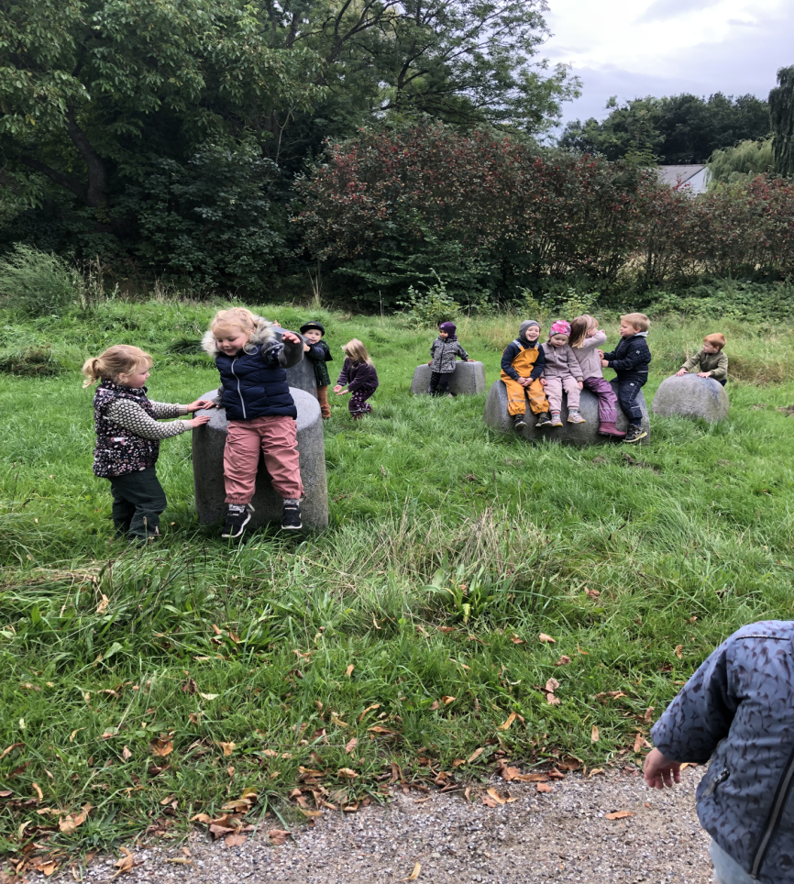
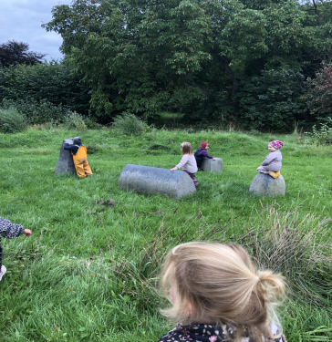
Blue slime and stones – science projects with friends

Slide 12
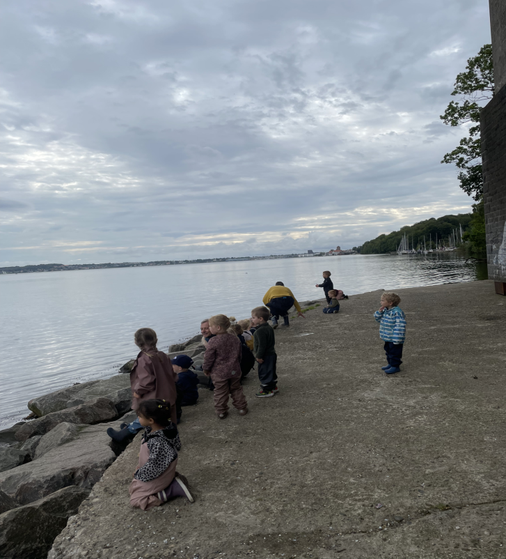
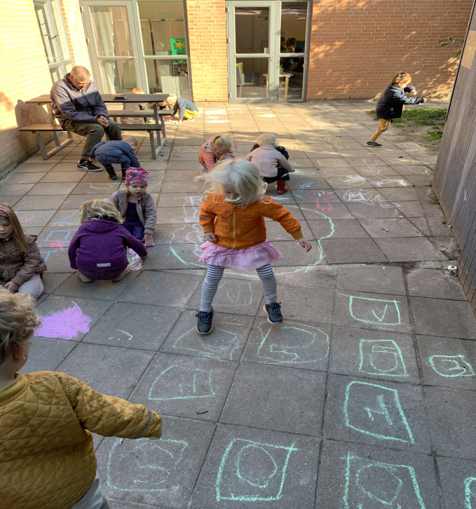
Playing with symbols and finding nature

Slide 13
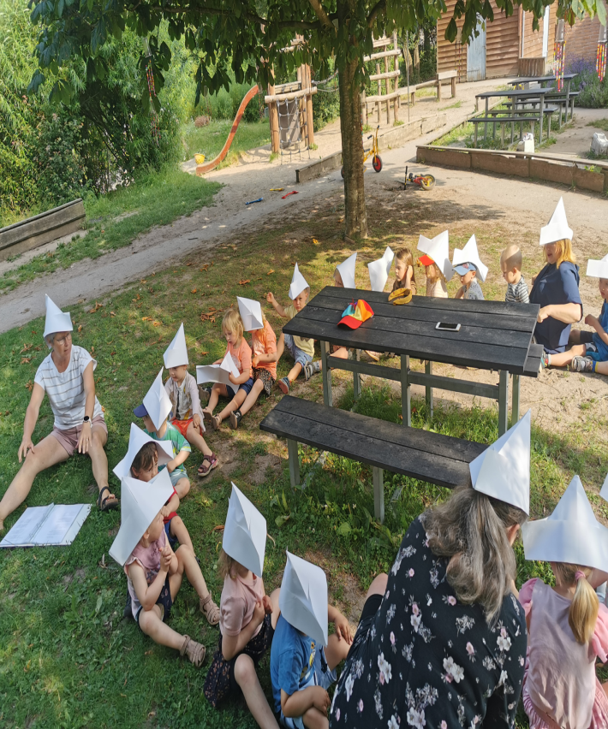
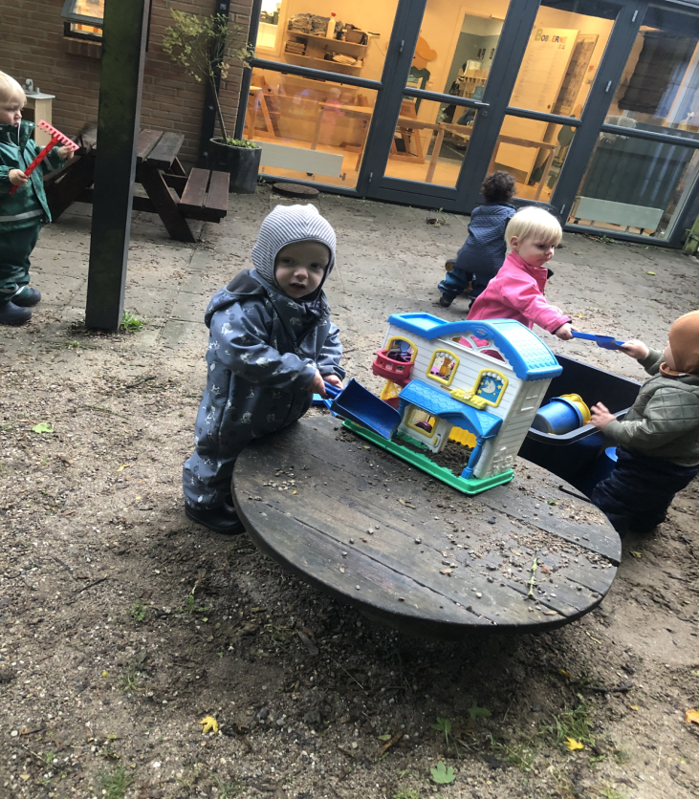
Pirat- treasure hunt and outdoor living

Slide 14
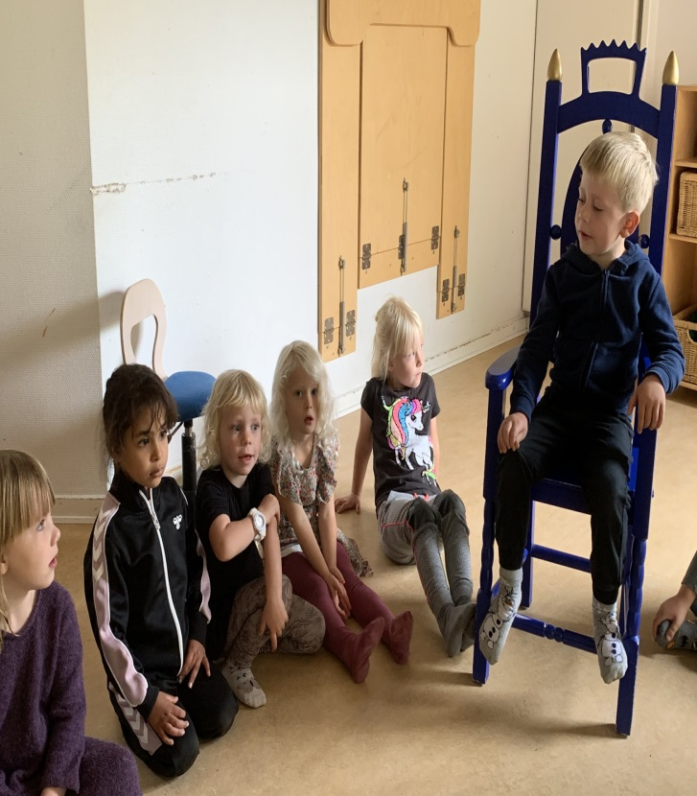
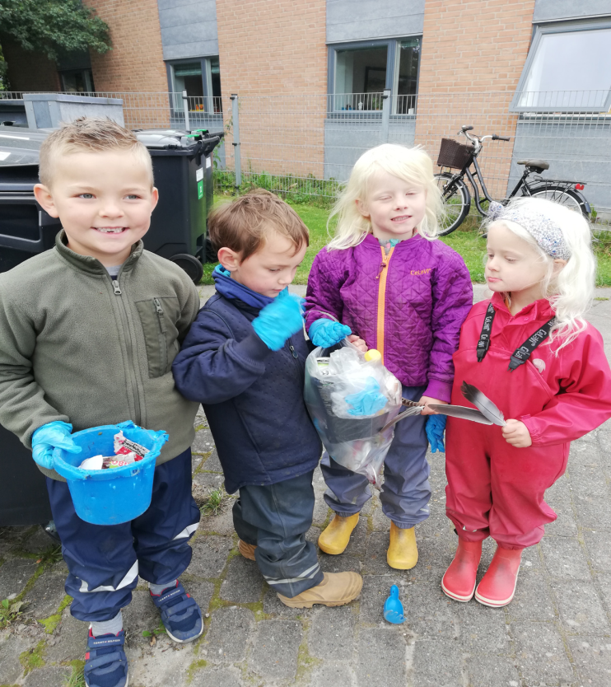
Birthday king and collecting plastic in nature

Slide 15
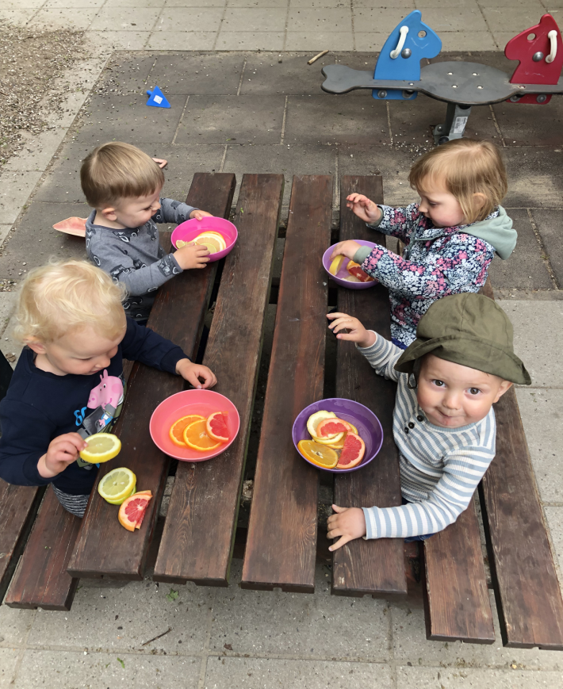
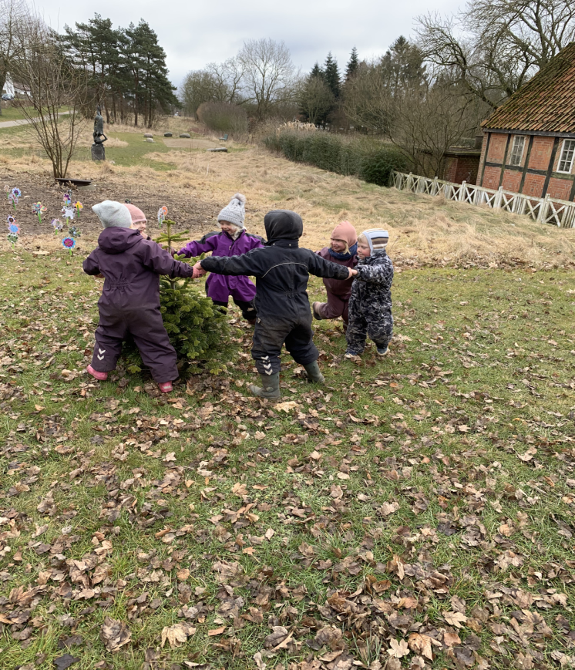
Sweet and sour science and dancing around the christmastree

Slide 16
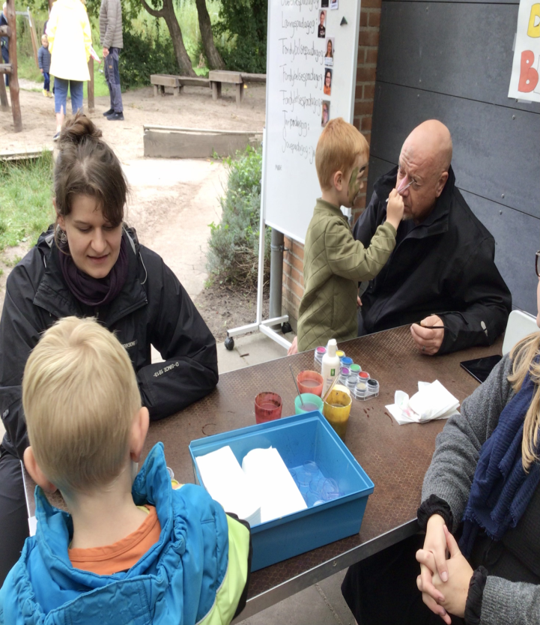
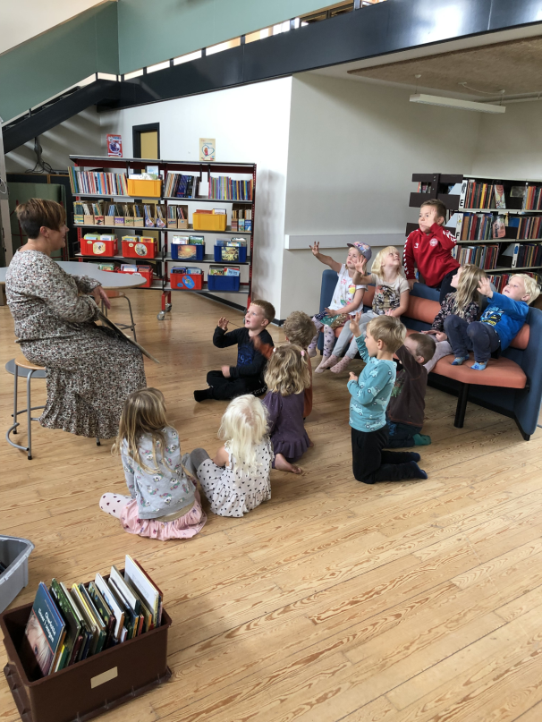
Grandparents-day and at our school library

Slide 17
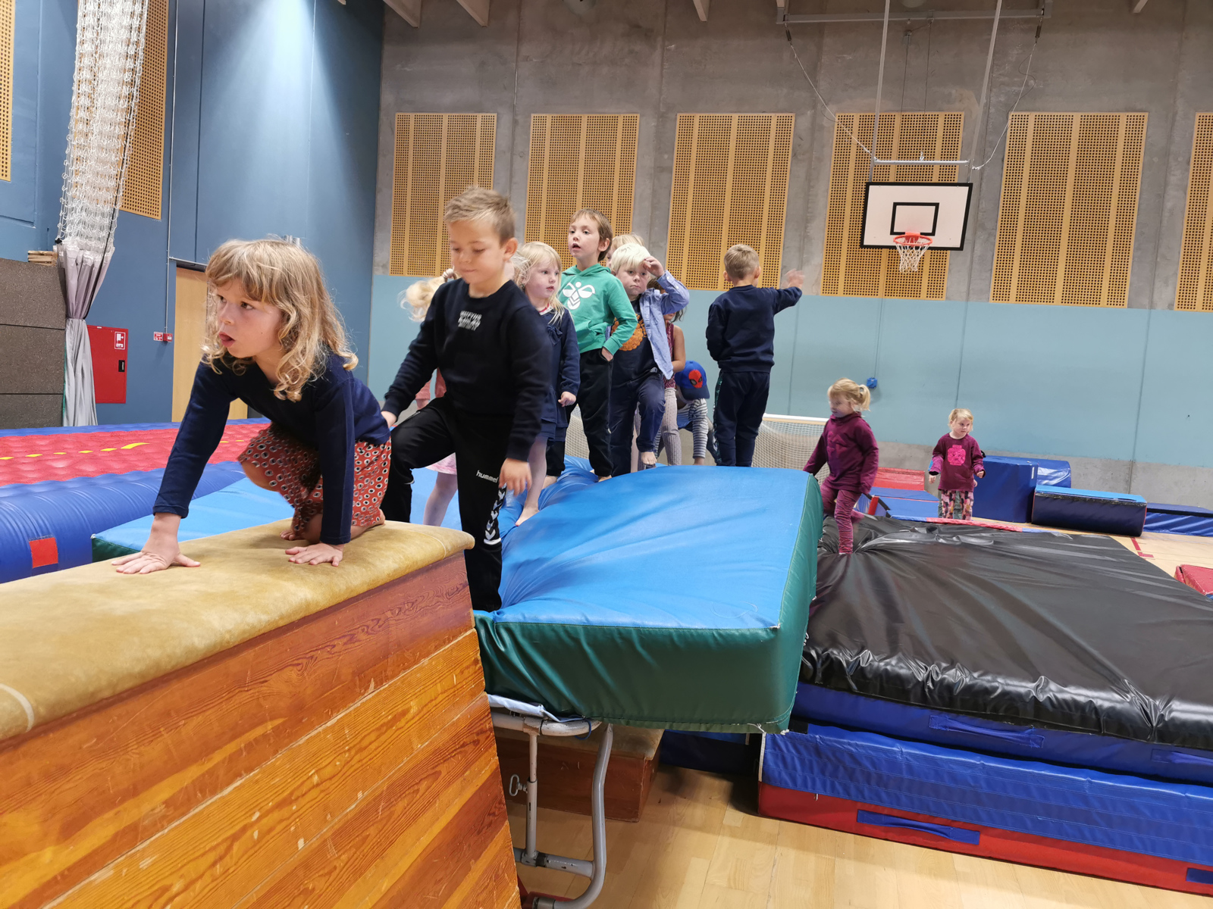

Thank you for visiting us

